Slide 1
Exploring and Classifying Indian Food Images using Machine Learning
Srinivas Naidu Pasyavula
QC61851
DATA 602
Prof. Venkatesh Krishnamoorthy

Slide 2
Table of Contents
Introduction
Dataset Description
Data Analysis and EDA
Visualization
Models
Metrics
Conclusion

Slide 3
Introduction
The Indian Food Images dataset is a collection of more than 4,000 images of various Indian dishes, including biryani, samosas, dosas, curries, and many more.
It is available on Kaggle and can be used for various applications in the field of computer vision, such as image classification, object recognition, and image segmentation.
The dataset is divided into two parts, the training set, and the test set, with 3,174 and 1,276 images, respectively. Each image in the dataset is associated with a label indicating the type of dish it represents.

Slide 4
Data Description
Data Source - Indian Food Images Data Set
Acknowledgment - This Dataset is created from Google Images: https://images.google.com/
4000+ Images of the Indian Food

Slide 5
Data Analysis and EDA
Load the dataset and explore its structure, including the number of images and their labels.
Visualize the images in the dataset to get an idea of the different types of dishes.
Analyze the distribution of different types of dishes in the dataset and identify any class imbalance.
Preprocess the images, including resizing, normalization, and data augmentation, to prepare them for machine learning models.
Split the dataset into training and test sets and use them to train and evaluate various machine learning models.
Analyze the performance of the models using various evaluation metrics and identify ways to improve their performance.

Slide 6
Visualization
Sample images from the dataset with their corresponding labels to get an idea of the different types of dishes in the dataset.
Histograms and pie charts to show the distribution of different types of dishes in the dataset.
Confusion matrix and classification report to evaluate the performance of our machine learning models.

Slide 7
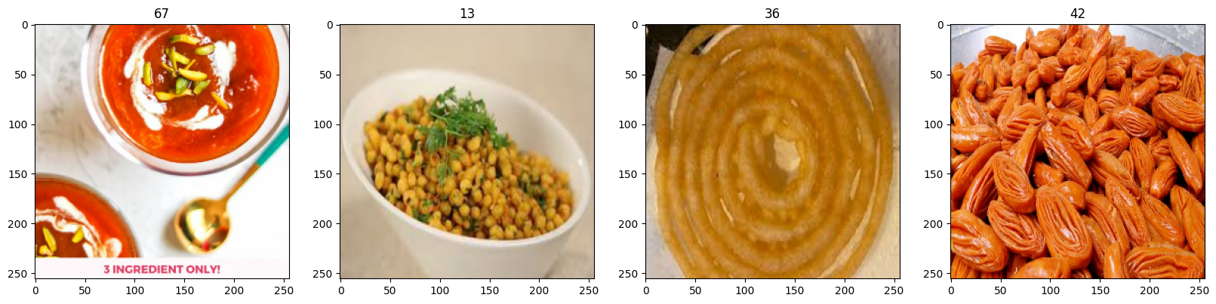
Indian Food Images
Sample data from Indian Food Images

Slide 8
Models
The Indian Food Images dataset can be used to train various machine learning and deep learning models for image classification. Some of the commonly used models for this task include:
Convolutional Neural Networks (CNNs): CNNs are a type of deep neural network that is widely used for image recognition tasks. They are particularly useful for tasks that involve identifying visual patterns in images.
Transfer Learning: Transfer learning is a technique that involves using pre-trained models as a starting point for training a new model. This technique can be useful when working with limited data or when training time is a constraint.

Slide 9
Metrics
Accuracy: Accuracy is the most common metric for evaluating the performance of classification models. It measures the percentage of correctly classified images in the dataset.
Precision and Recall: Precision and recall are two complementary metrics that measure the quality and completeness of the model's predictions, respectively. Precision measures the percentage of true positive predictions out of all positive predictions, while recall measures the percentage of true positive predictions out of all actual positive examples.

Slide 10
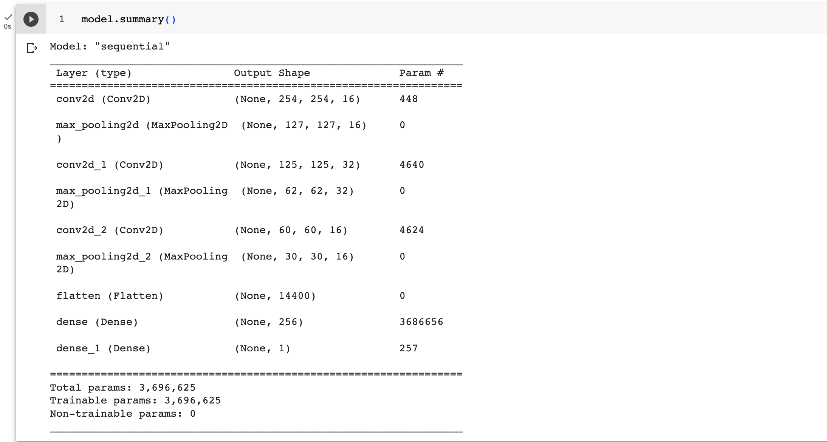
Model Summary

Slide 11
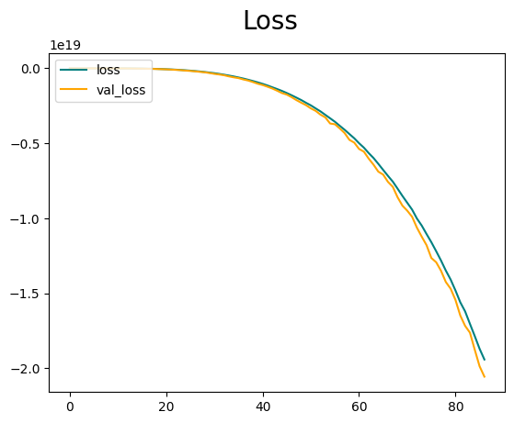
Model Performance

Slide 12
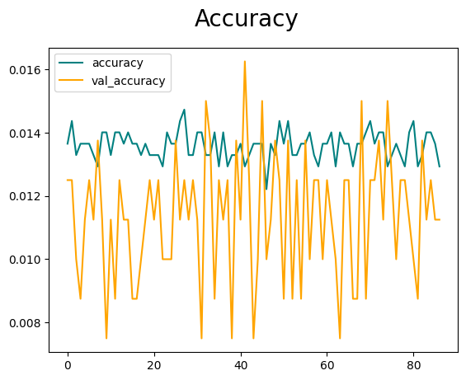
Model Performance

Slide 13
Conclusion
In this project, we will explore the Indian Food Images dataset, which is a collection of more than 4,000 images of various Indian dishes.
A deep Learning model that is used for image classification, including convolutional neural networks and transfer learning. We also identified various visualizations that can be used to explore the dataset and evaluate the performance of machine learning models.
This Model predicts the type of Indian Food based on the given input image.

Slide 14
References
Data Source - Indian Food Images Data Set
Acknowledgment - This Dataset is created from Google Images: Google Images
Code Reference: Technical Reference

